Slide 1

TVM: An Automated End-to-End Optimizing Compiler for Deep Learning
Xiaoyang Wang
University of Illinois at Urbana-Champaign
Notes:
NOTE:
To change the image on this slide, select the picture and delete it. Then click the Pictures icon in the placeholder to insert your own image.

Slide 2
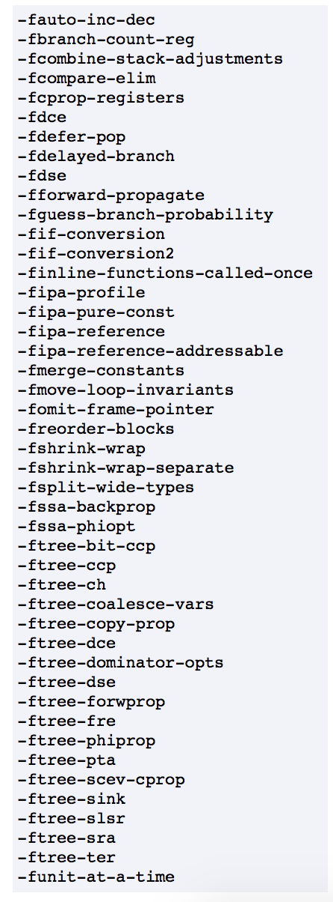
Compiler Tuning
Many compiler optimization techniques.
Select the optimal subset is a non-trivial task.
Has been studied for at least one or two decades.
GCC –O1

Slide 3
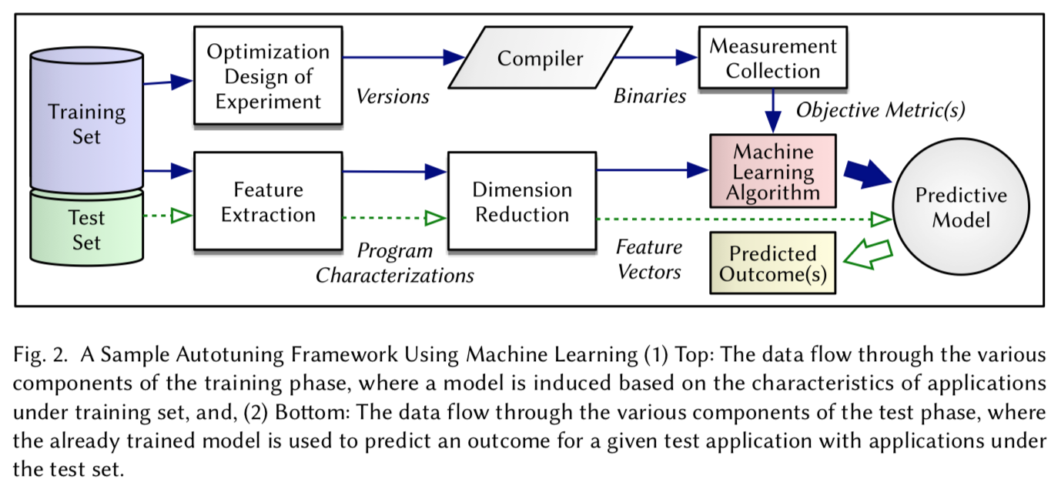
Survey on Compiler Autotuning using Machine Learning (ACM Computing Surveys 2018)
Program is too complicated.
Features are not representative enough compare to the complexity of programs.
Solutions are not general enough.

Slide 4
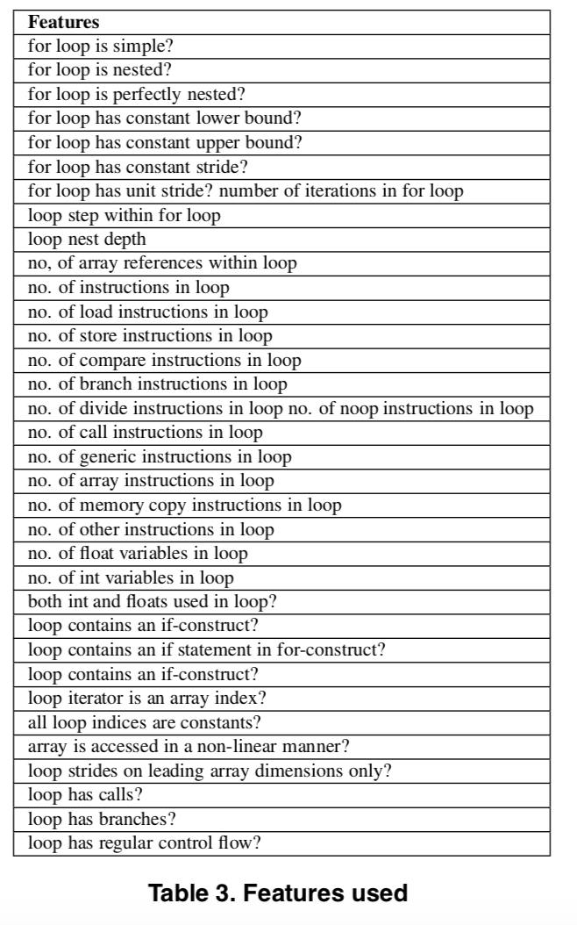
Using Machine Learning to Focus Iterative Optimization (CGO 2006)
Feature specific to loops.
A program has way more important components than loops.

Slide 5
The keys to TVM’s success
Programs are represented as compute graphs.
Homogenous components(MatMul) in each program.
Representative features for matrix multiplication.
ResNet

Slide 6
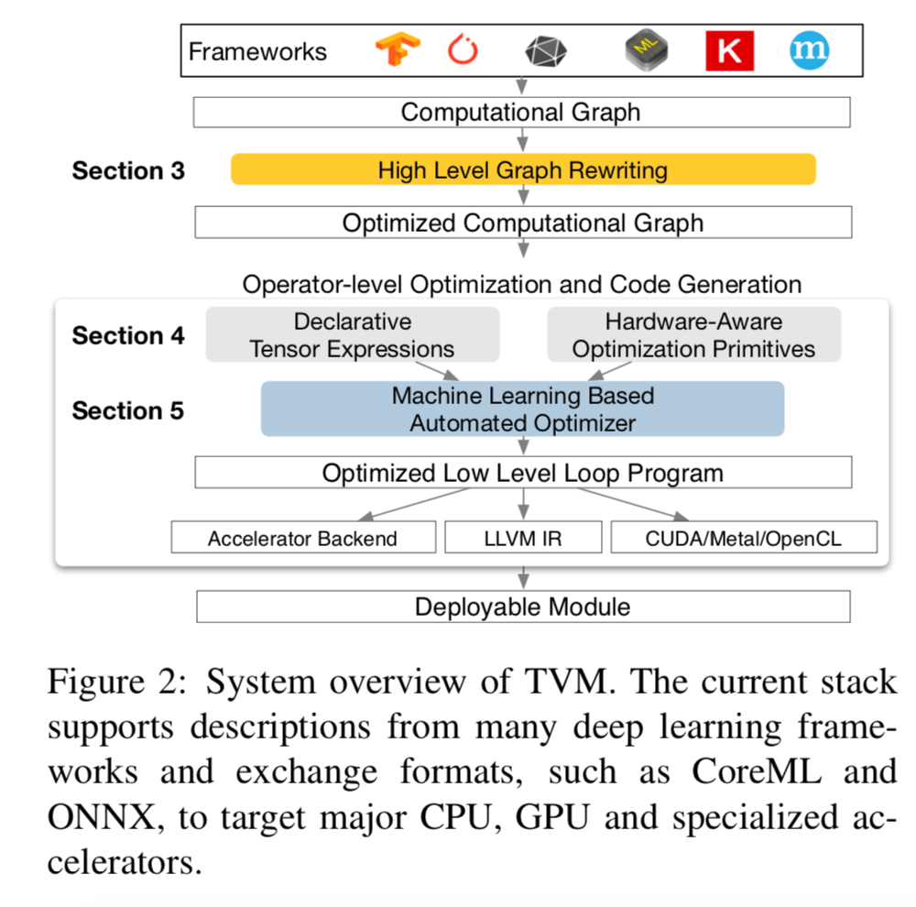
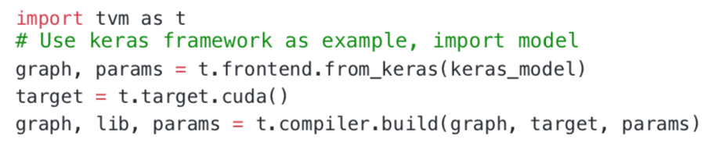
Overview of TVM
To use:
Computational graph (graph)
Generated operators (lib)
Module parameters (params)

Slide 7
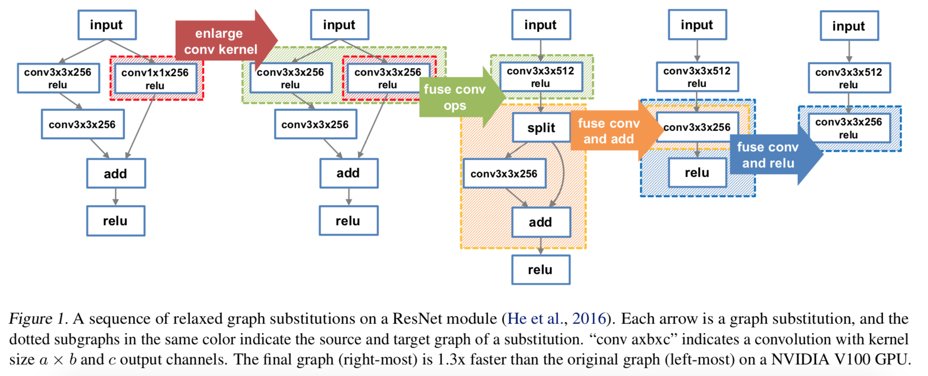
Graph-level Optimization
Accelerate computation.
But might generate more diverse operators.
Jia, Zhihao, et al. "Optimizing DNN computation with relaxed graph substitutions." Proc. Conference on Systems and Machine Learning, SysML. Vol. 19. 2019.

Slide 8
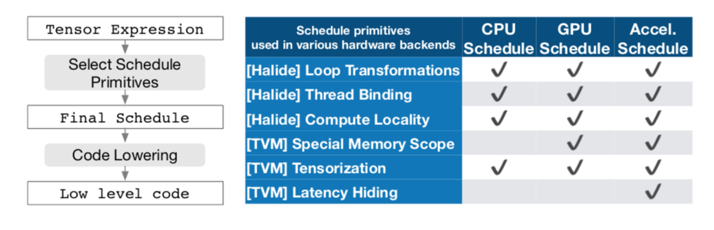
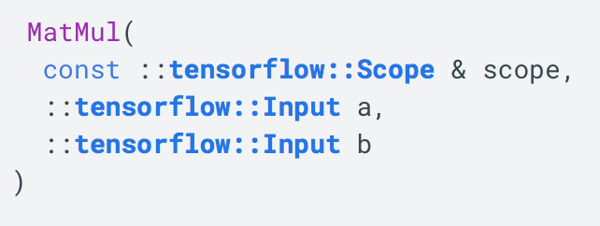
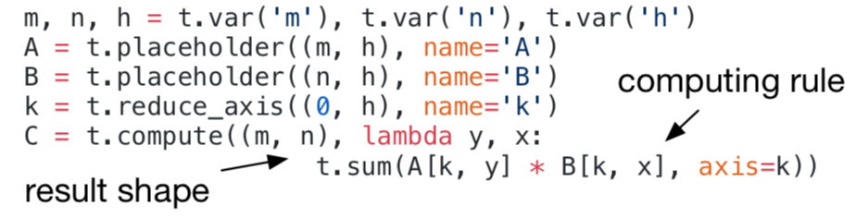
Operator-level Optimization: Extended Halide Abstraction.
Halide (Extension): Decouple compute/schedule/(Hardware).
Tensor expression is a definition.
Schedule decides how a expression will be implemented.
TensorFlow/Python
TVM/New Language
Ragan-Kelley, Jonathan, et al. "Halide: a language and compiler for optimizing parallelism, locality, and recomputation in image processing pipelines." Acm Sigplan Notices. Vol. 48. No. 6. ACM, 2013.

Slide 9
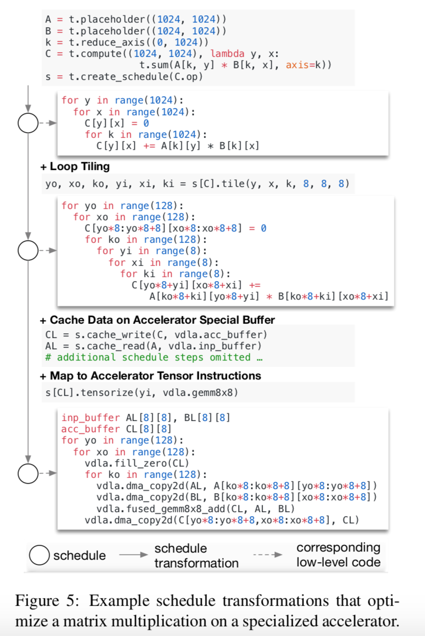
Operator-level Optimization: Example Schedule Transformation
Schedule: Program transformation.
Manually optimize a program is non-trivial.
Case study:
Loop Tiling.
Data Caching.
Leverage hardware specific intrinsic.
Loop unrolling and etc.

Slide 10
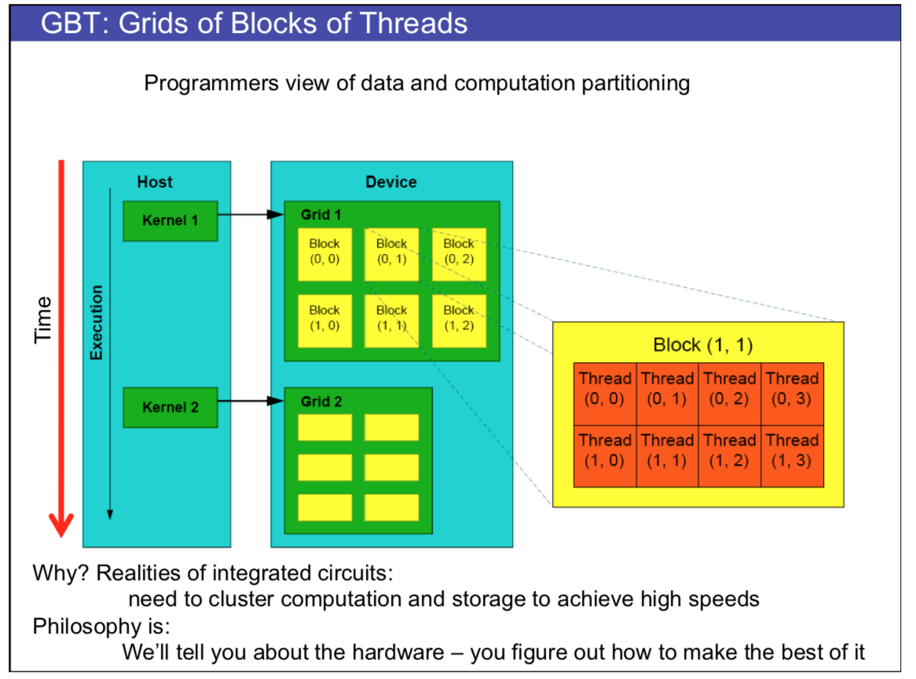
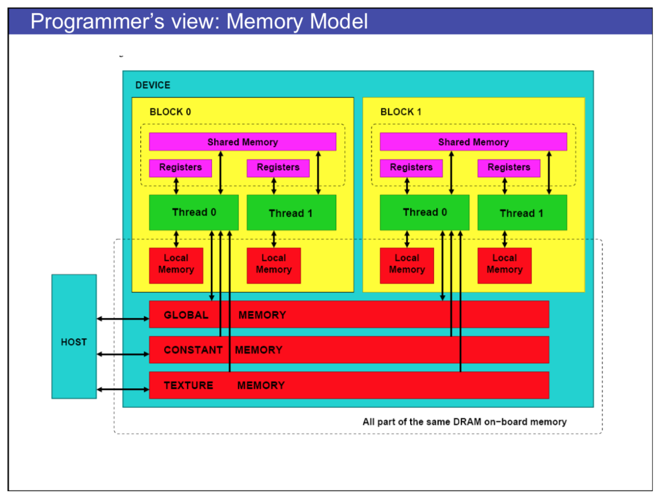
Operator-level Optimization: GPU Architecture

Slide 11
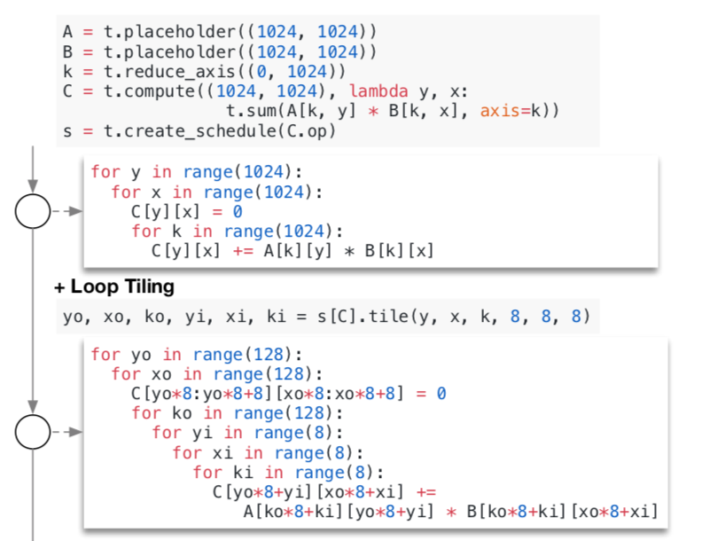
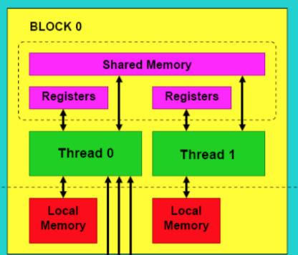
Operator-level Optimization: Loop Tiling
Optimize cache hit rate.

Slide 12
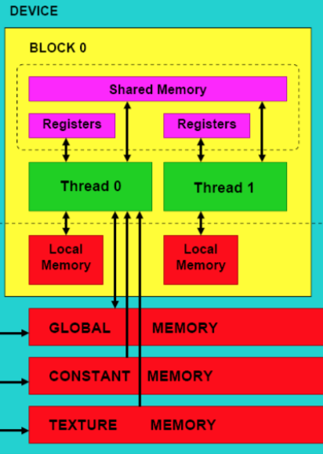
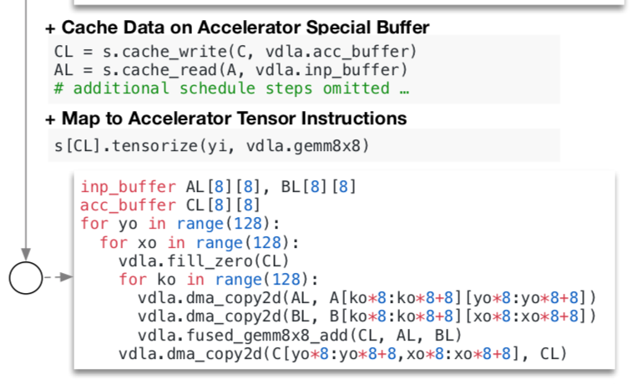
Operator-level Optimization: Data Caching
Reduce memory movement cost.

Slide 13
Operator-level Optimization: Hardware/Software Specific Instructions
Speed up computation.
Hardware instructions.
Software libraries.
Another example of Intel vectorization instructions
Gemm is a software library

Slide 14
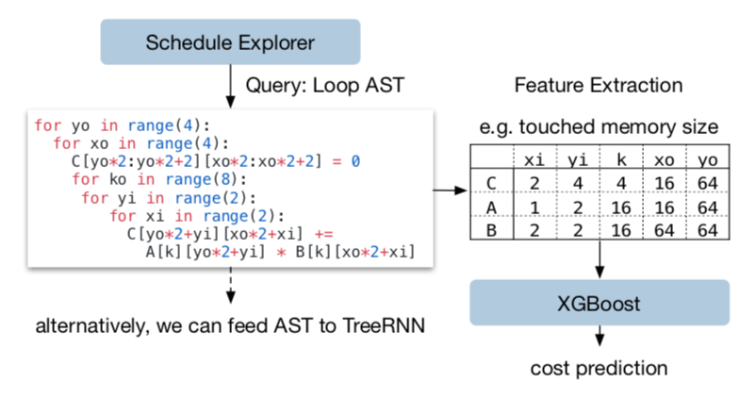
Operator-level Optimization: Features
Not hard to get via program analysis.

Slide 15
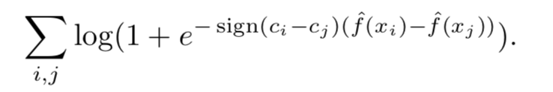
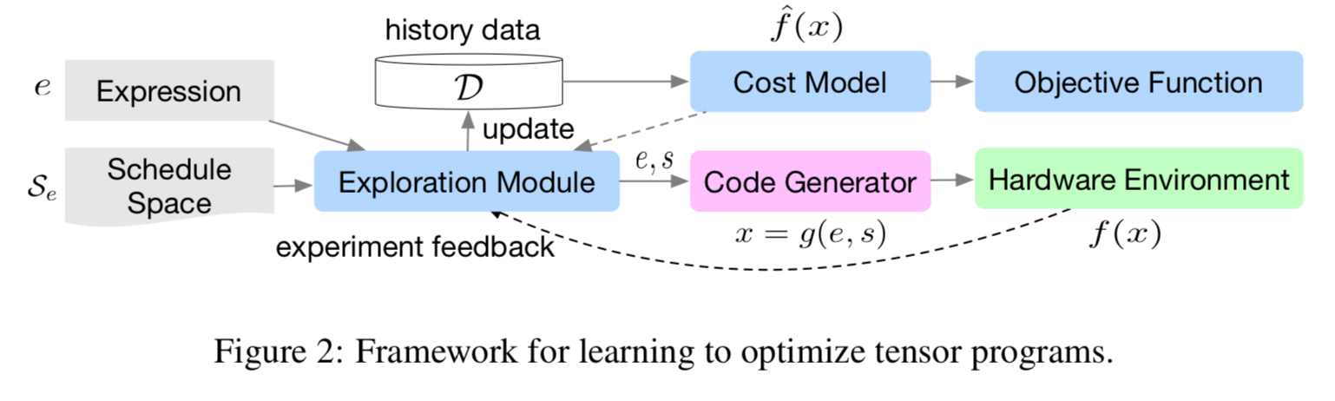
Autotuning Framework with XGBoost and RNN
Simply apply XGBoost and TreeGRU yields good performance here.
Use simulated annealing to get top-k best candidates.
Use random search to increase candidates diversity.
Run top-k candidates on real hardware via RPC.
Pick the best one.
Loss function: Learn to rank[1] relative cost using e and S
[1] Burges, Christopher, et al. "Learning to rank using gradient descent." Proceedings of the 22nd International Conference on Machine learning (ICML-05). 2005.

Slide 16
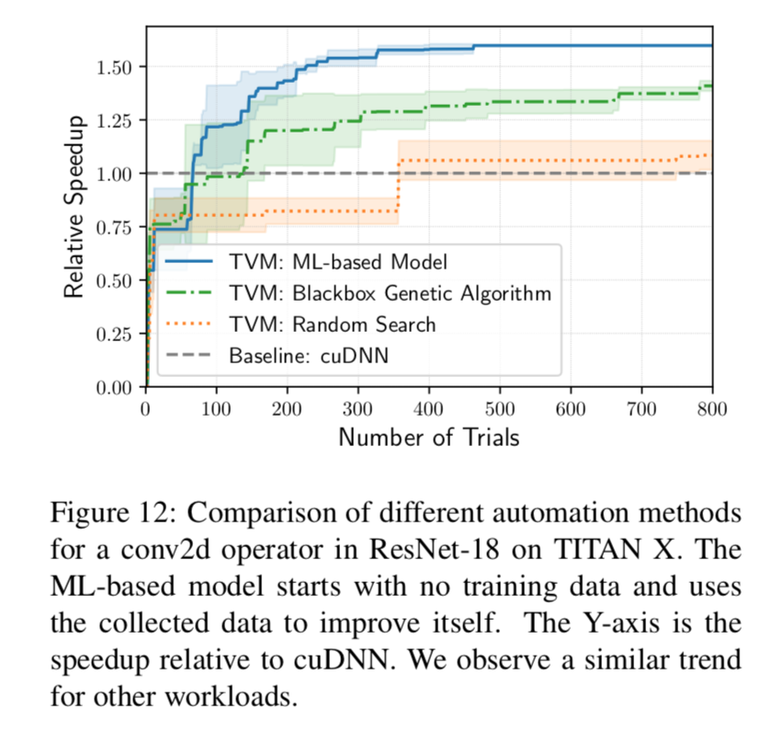
Compare to Nvidia cuDNN
Comparable on popular benchmarks.
Outperforms on non-popular programs. (Showed in Tianqi’s talk)

Slide 17
Contribution
New language provides a friendly abstraction.
New abstraction enables informative feature extraction.

Slide 18
Future Work
Research:
How to apply autoTVM to more diverse programs, such as data preprocessing.
Product:
Better front-end support.
Get human out of the TVM optimization loop.
Will specialized hardware dominate the future?

Slide 19
SAMPL
https://sampl.cs.washington.edu

Slide 20
Petuum
https://petuum.com

